Slide 1
Decision Trees

Slide 2
Decision Trees
Prediction:
Based on a bunch of IF … THEN … ELSE … rules
Fitting:
Find a bunch of IF … THEN … ELSE … rules to cover all cases as best you can.

Slide 3
Day | Outlook | Temp | Hum. | Wind | Play Tennis
0 l | Sunny | Hot | High | Weak | No
02 | Sunny | Hot | High | Strong | No
03 | Overcast | Hot | High | Weak | Yes
04 | Rain | Mild | High | Weak | Yes
05 | Rain | Cool | Nml | Weak | Yes
06 | Rain | Cool | Nml | Strong | No
07 | Overcast | Cool | Nml | Strong | Yes
08 | Sunny | Mild | High | Weak | No
09 | Sunny | Cool | Nml | Weak | Yes
10 | Rain | Mild | Nml | Weak | Yes
11 | Sunny | Mild | Nml | Strong | Yes
12 | Overcast | Mild | High | Strong | Yes
13 | Overcast | Hot | Nml | Weak | Yes
14 | Rain | Mild | High | Strong | No

Slide 4
Outlook
Sunny
Overcast
Rain
Humidity
Yes
Wind
High
Normal
Strong
Weak
No
Yes
No
Yes

Slide 5
Each inner node is a decision based on a feature Each leaf node is a class label
Outlook
Sunny
Overcast
Rain
Humidity
Yes
Wind
High
Normal
Strong
Weak
No
Yes
No
Yes

Slide 6
Each inner node is a decision based on a feature Each leaf node is a class label
Predicting Titanic Survivors
Yes
Is sex male?
No
Is age > 9.5?
Survived
0.73
36%
Died
Is sibsp > 2.5?
0.17
61%
Died
Survived
0.05
2%
0.89
2%
Notes:
How is the probability computed?

Slide 7
It can also be used for regression
CART
(Classiﬁcation and Regression Tree)

Slide 8
Each inner node is a decision based on a feature
Each leaf node is a predicted value
Predicting precipitation in Himalayas from elevation, slope and position
elev < 7910
Slope < 20
elev < 8650
Slope < 2.5
25.000
posabe
10.120
elev < 7370
1.080
15.510
elev < 8135
1.375
elev < 7690
18.000
elev < 8325
55.420
5.200
60.000
Slope < 2.5
13.670
elev < 8490
27.500
48.500
Notes:
Notice this is regression! How is the final number computed?

Slide 9
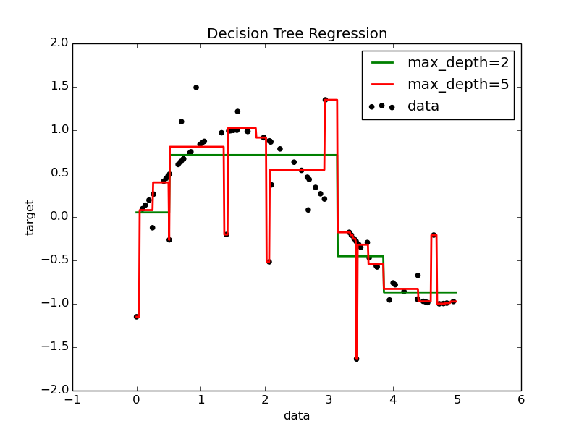

Slide 10
from sklearn.tree import DecisionTreeClassiﬁer
from sklearn.tree import DecisionTreeRegressor

Slide 11
Advantages:
The decisions are easy to understand and interpret.
Both numerical and categorical features can be used naturally. Natural multiclass classiﬁer.

Slide 12
Advantages:
The decisions are easy to understand and interpret.
Both numerical and categorical features can be used naturally. Natural multiclass classiﬁer.
Disadvantages:
Can overﬁt to training data with complex trees.
Small changes in input data can result in totally diﬀerent trees. Can make mistakes with unbalanced classes.
No conﬁdence intervals (regression).

Slide 13
So, how do we build the best tree?

Slide 14
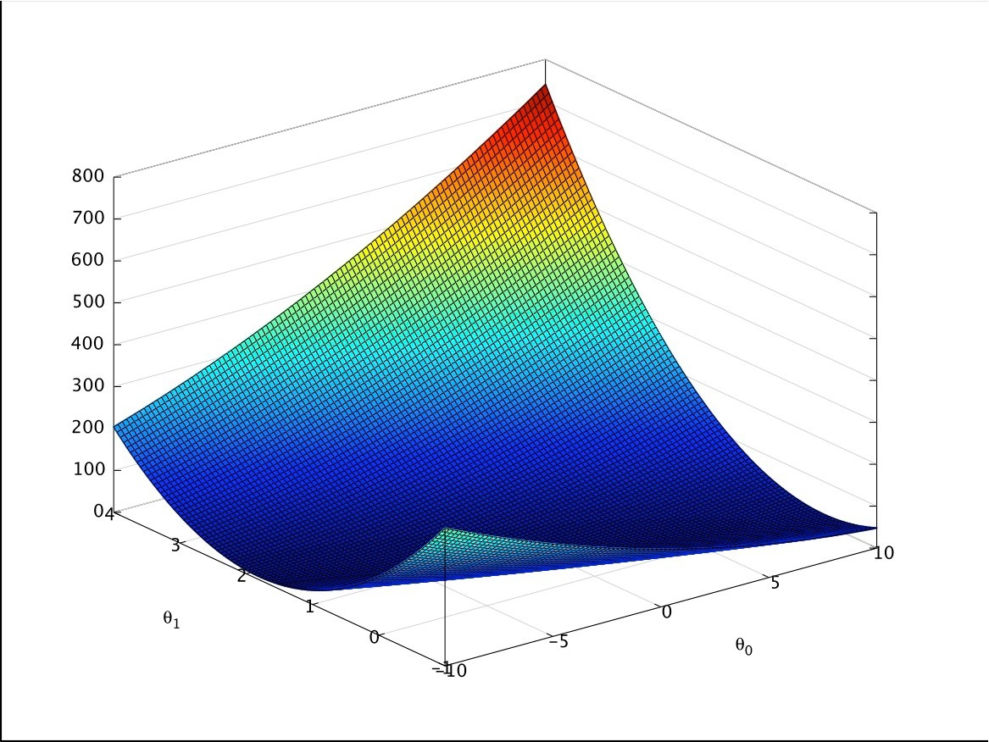







Like we ﬁt any other model?
Deﬁne a cost function:
a score for a speciﬁc model (tree)
Try a bunch of models (trees), choose best
Use optimization algorithm to try in a smart way

Slide 15
Like we ﬁt any other model?
Deﬁne a cost function:
a score for a speciﬁc model (tree)
Try a bunch of models (trees), choose best
Use optimization algorithm to try in a smart way

Slide 16
Build tree split by split,
ﬁnd the best split you can at each step
Notes:
DT are greedy heuristic algorithms: myopic but fast to compute

Slide 17
Build tree split by split,
ﬁnd the best split you can at each step
Yes
Is sex male?
No
Survived
0.73
36%

Slide 18
Build tree split by split,
ﬁnd the best split you can at each step
Yes
Is sex male?
No
Is age > 9.5?
Survived
0.73
36%
Died
0.17
61%

Slide 19
Build tree split by split,
ﬁnd the best split you can at each step
Yes
Is sex male?
No
Is age > 9.5?
Survived
0.73
36%
Died
Is sibsp > 2.5?
0.17
61%
Died
Survived
0.05
2%
0.89
2%

Slide 20
Use a heuristic: Greedy search
Build tree split by split,
ﬁnd the best split you can at each step
?

Slide 21
Information Entropy
1
0.5
0
0
0.5
p(x=1)
1
H = -∑p(x_{i} ) log p(x_{i} )
i
Notes:
When prob of one class in binary is .5, entropy is highest!!

Slide 22
Split with entropy minimization rule. Repeat.
Leaf node if only one class left
(or, if a performance metric
or maximum depth is reached)

Slide 23
Split with entropy minimization rule. Repeat.
Leaf node if only one class left
(or, if a performance metric
or maximum depth is reached)
Yes
Is sex male?
No
Survived
0.73
36%

Slide 24
Split with entropy minimization rule. Repeat.
Leaf node if only one class left
(or, if a performance metric
or maximum depth is reached)
Yes
Is sex male?
No
Is age > 9.5?
Survived
0.73
36%
Died
0.17
61%

Slide 25
Split with entropy minimization rule. Repeat.
Leaf node if only one class left
(or, if a performance metric
or maximum depth is reached)
Yes
Is sex male?
No
Is age > 9.5?
Survived
0.73
36%
Died
Is sibsp > 2.5?
0.17
61%
Died
Survived
0.05
2%
0.89
2%

Slide 26
May overﬁt. Prune.
Yes
Is sex male?
No
Is age > 9.5?
Survived
0.73
36%
Died
Is sibsp > 2.5?
0.17
61%
Died
Survived
0.05
2%
0.89
2%
Notes:
Even though 5% and 89% really good, only 2% of population in each, so can you really trust the small sample’s results??

Slide 27
May overﬁt. Prune.
Yes
Is sex male?
No
Is age > 9.5?
Survived
0.73
36%
Died
Survived
0.17
61%

Slide 28
May overﬁt. Prune.
Yes
Is sex male?
No
Died
Survived
0.73
36%

Slide 29
Better yet: Use ensemble methods
Yes
Is sex male?
No
Yes
Is sex male?
No
Yes
Is sex male?
No
Yes
Is sex male?
No
Is age > 9.5?
Survived
Is age > 9.5?
Survived
Is age > 9.5?
Survived
Is age > 9.5?
Survived
0.73
36%
0.73
36%
0.73
36%
0.73
36%
Died
Is sibsp > 2.5?
Died
Is sibsp > 2.5?
Died
Is sibsp > 2.5?
Died
Is sibsp > 2.5?
0.17
61%
0.17
61%
0.17
61%
0.17
61%
Died
Survived
Died
Survived
Died
Survived
Died
Survived
0.05
2%
0.89
2%
0.05
2%
0.89
2%
0.05
2%
0.89
2%
0.05
2%
0.89
2%
Yes
Is sex male?
No
Yes
Is sex male?
No
Yes
Is sex male?
No
Is age > 9.5?
Survived
Is age > 9.5?
Survived
Is age > 9.5?
Survived
0.73
36%
0.73
36%
0.73
36%
Died
Is sibsp > 2.5?
Died
Is sibsp > 2.5?
Died
Is sibsp > 2.5?
0.17
61%
0.17
61%
0.17
61%
Died
Survived
Died
Survived
Died
Survived
0.05
2%
0.89
2%
0.05
2%
0.89
2%
0.05
2%
0.89
2%
Notes:
What’s the point? These are the same trees!
Yes but no. Let’s go to bagging!

Slide 30

Ensemble Methods: Bagging

Slide 31
Bootstrap aggregating
Problem:
Overfitting to training set
Solution:
Bootstrap training set into multiple sets Fit a model to each random set
Each model has one vote, choose max vote
Notes:
Bootstrap is sample with replacement

Slide 32
 | Date | Title | Budget | DomesticTotalGross | Director | Rating | Runtime
0 | 2013-11-22 | The Hunger Games: Catching Fire | 130000000 | 424668047 | Francis Lawrence | PG-13 | 146
1 | 2013-05-03 | Iron Man 3 | 200000000 | 409013994 | Shane Black | PG-13 | 128
2 | 2013-11-22 | Frozen | 150000000 | 400738009 | Chris BuckJennifer Lee | PG | 108
3 | 2013-07-03 | Despicable Me 2 | 760000000 | 368061265 | Pierre CoffinChris Renaud | PG | 98
4 | 2013-06-14 | Man of Steel | 225000000 | 291045518 | Zack Snyder | PG-13 | 143
5 | 2013-10-04 | Gravity | 100000000 | 274092705 | Alfonso Cuaron | PG-13 | 91
6 | 2013-06-21 | Monsters University | NaN | 268492764 | Dan Scanion | G | 107
7 | 2013-12-13 | The Hobbit: The Desolation of Smaug | NaN | 258366855 | Peter Jackson | PG-13 | 161
8 | 2013-05-24 | Fast & Furious 6 | 160000000 | 238679850 | Justin Lin | PG-13 | 130
9 | 2013-03-08 | OZ The Great and Powerful | 215000000 | 234911825 | Sam Raimi | PG | 127
10 | 2013-05-16 | Star Trek Into Darkness | 190000000 | 228778661 | J.J. Abrams | PG-13 | 123
11 | 2013-11-08 | Thor: The Drak World | 170000000 | 206362140 | Alan Taylor | PG-13 | 120
12 | 2013-06-21 | World War Z | 190000000 | 202359711 | Marc Forster | PG-13 | 116
13 | 2013-03-22 | The Croods | 135000000 | 187168425 | Kirk De MiccoChris Sanders | PG | 98
14 | 2013-06-28 | The Heat | 43000000 | 159582188 | Paul Feig | R | 117
15 | 2013-08-07 | We're the Millers | 37000000 | 150394119 | Rawson Marshall Thurber | R | 110
16 | 2013-12-13 | American Hustle | 40000000 | 150117807 | David O. Russell | R | 138
17 | 2013-05-10 | The Great Gatsby | 105000000 | 144840419 | Baz Luhrmann | PG-13 | 143
Training set
Test set

Slide 33
Bootstrap: Sample with replacement

Slide 34
Bootstrap: Sample with replacement
Yes
Is sex male?
No
Is age > 9.5?
Survived
Died
0.73
36%
0.17
61%
Is sibsp > 2.5?
Died
Survived
0.05
2%
0.89
2%
Yes
Is sex male?
No
Is age > 9.5?
Survived
Died
0.73
36%
Is sibsp > 2.5?
0.17
61%
Died
Survived
0.05
2%
0.89
2%
Yes
Is sex male?
No
Is age > 9.5?
Survived
Died
0.73
36%
Is sibsp > 2.5?
0.17
61%
Died
Survived
0.05
2%
0.89
2%
Yes
Is sex male?
No
Is age > 9.5?
Survived
Died
0.73
36%
0.17
61%
Is sibsp > 2.5?
Died
Survived
0.05
2%
0.89
2%

Slide 35
Classiﬁcation: Major vote
Regression: Average outcome
Yes
Is sex male?
No
Is age > 9.5?
Survived
Died
0.73
36%
0.17
61%
Is sibsp > 2.5?
Died
Survived
0.05
2%
0.89
2%
Yes
Is sex male?
No
Is age > 9.5?
Survived
Died
0.73
36%
Is sibsp > 2.5?
0.17
61%
Died
Survived
0.05
2%
0.89
2%
Yes
Is sex male?
No
Is age > 9.5?
Survived
Died
0.73
36%
Is sibsp > 2.5?
0.17
61%
Died
Survived
0.05
2%
0.89
2%
Yes
Is sex male?
No
Is age > 9.5?
Survived
Died
0.73
36%
0.17
61%
Is sibsp > 2.5?
Died
Survived
0.05
2%
0.89
2%
Notes:
That’s why crowd wisdom works for guessing the bull at county fairs, or for tempering extremes in democracy.

Slide 36
from sklearn.ensemble import BaggingClassiﬁer

Slide 37
Ensemble Methods:
Random Forests

Slide 38
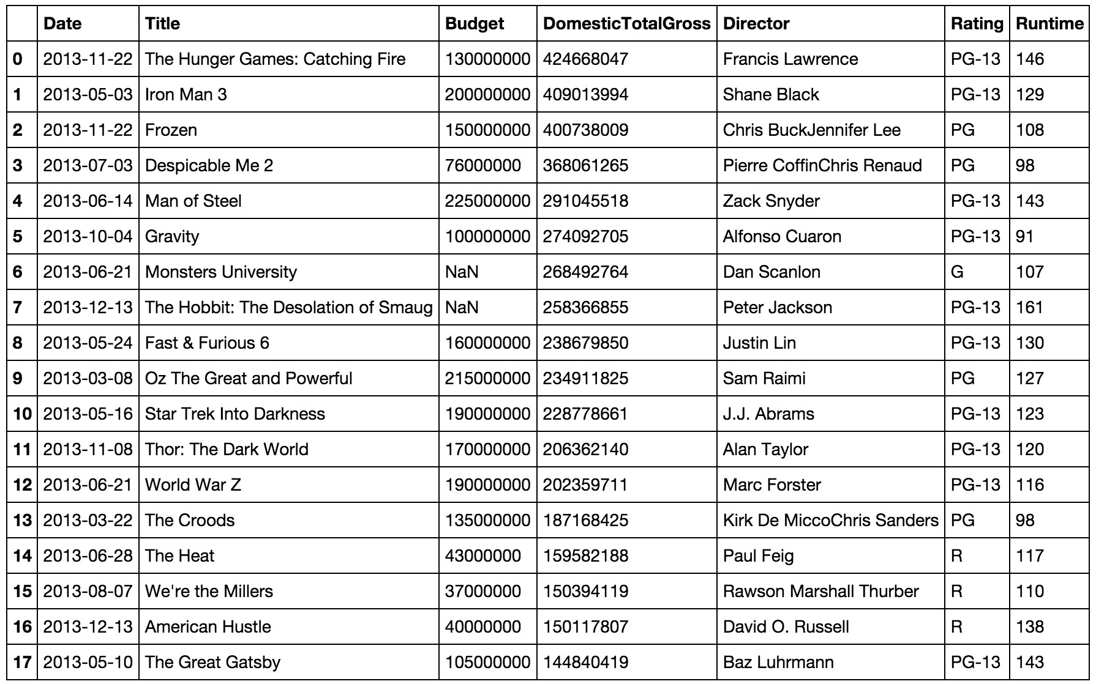
Tree Bagging with a twist
Yes
Is sex male?
No
Is age > 9.5?
Survived
Died
0.73
36%
0.17
61%
Is sibsp > 2.5?
Died
Survived
0.05
2%
0.89
2%
Yes
Is sex male?
No
Is age > 9.5?
Survived
Died
0.73
36%
Is sibsp > 2.5?
0.17
61%
Died
Survived
0.05
2%
0.89
2%
Yes
Is sex male?
No
Is age > 9.5?
Survived
Died
0.73
36%
Is sibsp > 2.5?
0.17
61%
Died
Survived
0.05
2%
0.89
2%
Yes
Is sex male?
No
Is age > 9.5?
Survived
Died
0.73
36%
0.17
61%
Is sibsp > 2.5?
Died
Survived
0.05
2%
0.89
2%

Slide 39
Introduce randomness when building each tree.
Yes
Is sex male?
No
Is age > 9.5?
Survived
0.73
36%

Slide 40
Introduce randomness when building each tree. For a split, do not take the “best” feature split.
Yes
Is sex male?
No
Is age > 9.5?
Survived
0.73
36%

Slide 41
Introduce randomness when building each tree. For a split, do not take the “best” feature split.
First, randomly choose sqrt(n_feat) features.
Yes
Is sex male?
No
Is age > 9.5?
Survived
0.73
36%

Slide 42
Introduce randomness when building each tree. For a split, do not take the “best” feature split.
First, randomly choose sqrt(n_feat) features.
Only choose the best split among these.
Yes
Is sex male?
No
Is age > 9.5?
Survived
0.73
36%
Notes:
Number of tried attributes will depend. If you already have some a priori about the way the information is spreading or not among the features. If the information is shared by many features, better results would come up with smaller value of that parameter. While, on the other hand, if only a few features are carrying the information, you should use larger values. In other words, with many relevant variables : smaller values are better and with many irrelevant variables : bigger values are better.

Slide 43
from sklearn.ensemble import RandomForestClassiﬁer
from sklearn.ensemble import RandomForestRegressor

Slide 44
from sklearn.ensemble import RandomForestClassiﬁer
from sklearn.ensemble import RandomForestRegressor
from sklearn.ensemble import ExtraTreesClassiﬁer?

Slide 45
from sklearn.ensemble import RandomForestClassiﬁer
from sklearn.ensemble import RandomForestRegressor
from sklearn.ensemble import ExtraTreesClassiﬁer
Even more randomized:
For each feature, split rule is random, not optimal

